Slide 1
Mini Project
Jayesh Mahajan
Maitreya Darokar
Jenil Jain
Kuldeep Chotrani
Ketan

Slide 2
Objective
To predict the type and Class of the Jowar seeds by their size ,color and texture data.

Slide 3
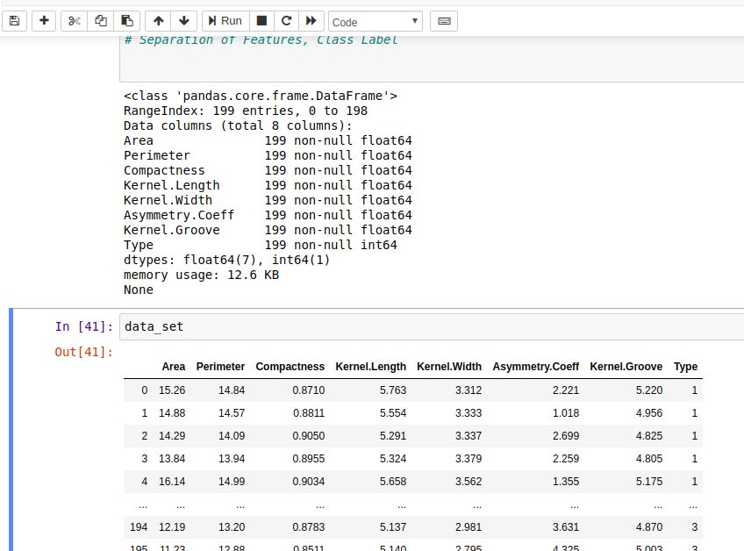
Data Set

Slide 4
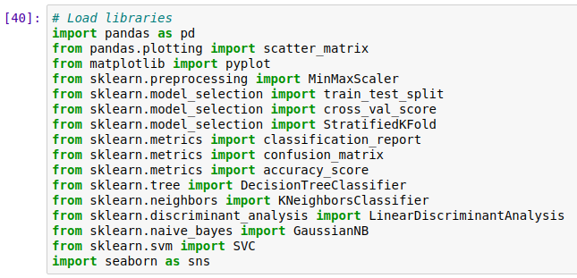

Libraries used
Data preprocessing

Slide 5
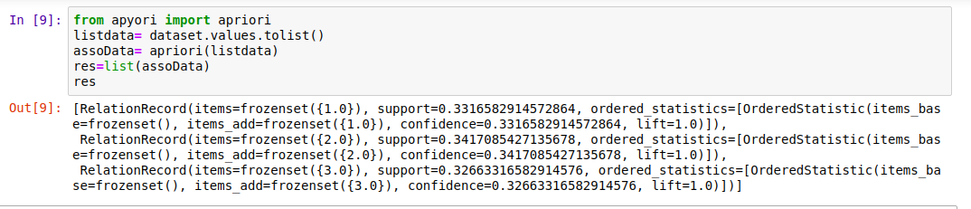
Association Rule Mining
Applying Apriori to Find Frequent Patterns in the data set

Slide 6
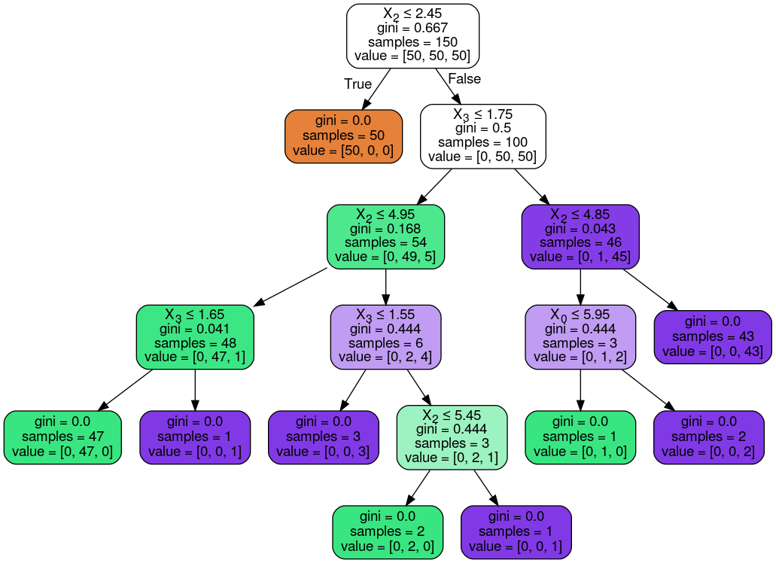
Decision Tree

Slide 7
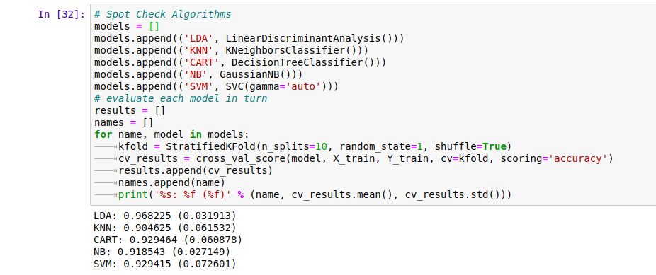
Prediction Model Selection(algorithm selection)

Slide 8
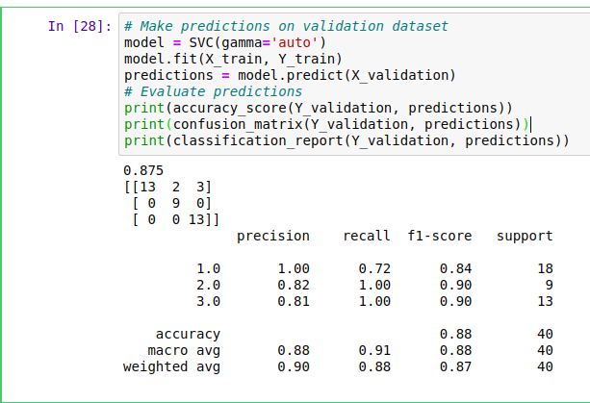
Confusion Matrix
SVM model is used as its Accuracy score is highest among the other Models for this prediction.
Below is the classification report for the SVM model.

Slide 9
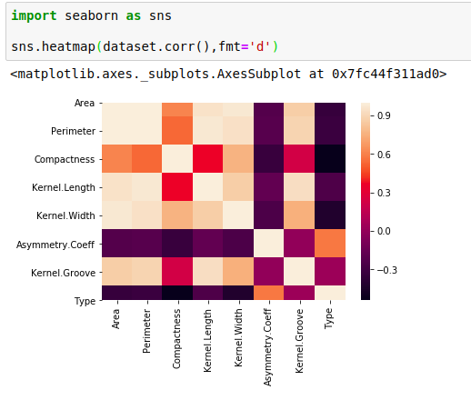
Correlation between Attributes

Slide 10
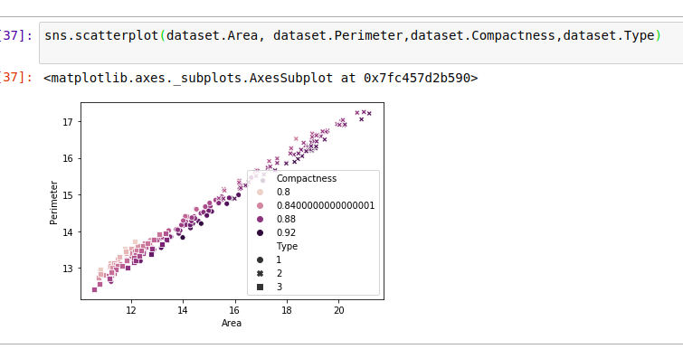
Visualisation of the data using scatterplot

Slide 11
Thank You

